Slide 1
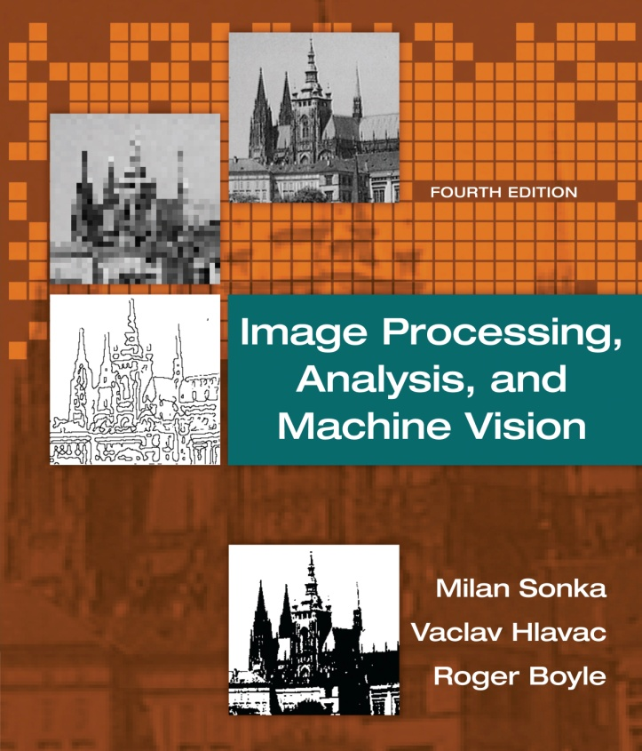

Chapter 2
Image Processing, Analysis, and Machine Vision, 4th Edition Sonka, Hlavac & Boyle
The image, its representations and properties

Slide 2
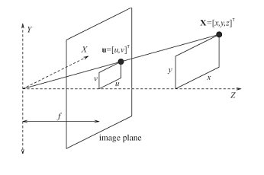
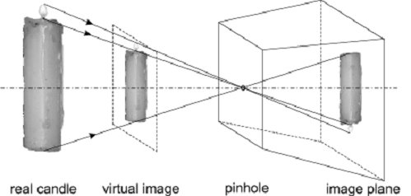


Image representations, a few concepts
Image Processing, Analysis, and Machine Vision, 4th Edition Sonka, Hlavac & Boyle
Perspective projection geometry
f : focal length
x, y, z: the co-ordinates of the point X in a 3D science
u, v: the co-ordinates in the 2D image plane
$$u=\frac{xf}{z}$$
$$v=\frac{yf}{z}$$

Slide 3
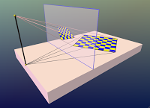
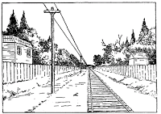
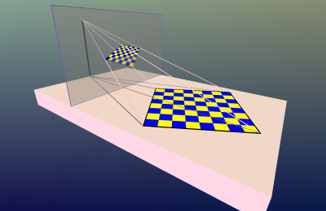
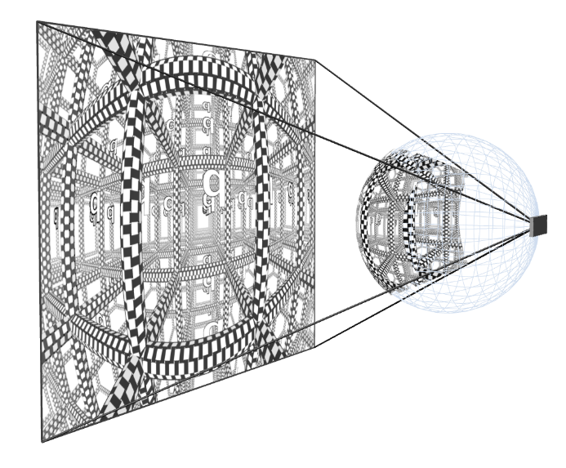
Projection geometry
http://cgunn3.blogspot.tw/2012/04/where-parallels-meet.html
http://page.math.tu-berlin.de/~gunn/pages/PGTalkImages/perspectiveDemo-04.png

Slide 4
Image representations, a few concepts
The quality of a digital image can be measured by
Spatial resolution (space)
The proximity (接近) of image samples in the image plane
Spectral resolution (color)
The bandwidth (頻寬) of the light frequencies captured by the sensor
Radiometric (輻射的) resolution (intensity)
The number of distinguishable gray-levels
Time resolution (temporal resolution)
The interval between time samples at which images are captured

Slide 5
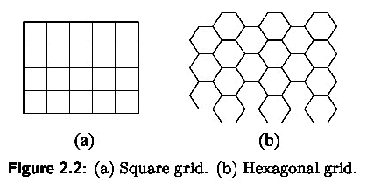
Image digitization
Image Processing, Analysis, and Machine Vision, 4th Edition Sonka, Hlavac & Boyle
Sampling
A continuous image is digitized at sampling points.
These sampling points are ordered in the plane, and their geometric relation is called the grid.
Grids used in practice are usually square or hexagonal.

Slide 6
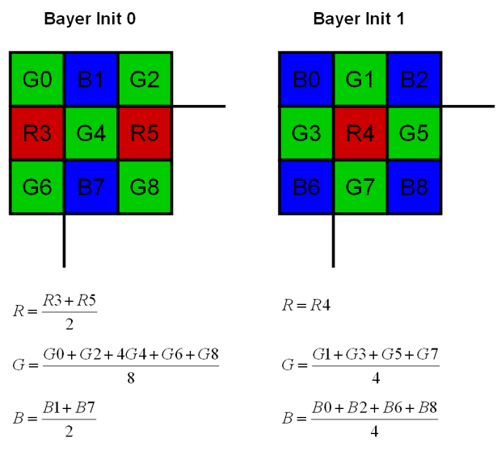
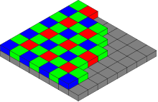
Grids
The Bayer color filter mosaic. (Very common RGB filter.) Each two-by-two submosaic contains 2 green, 1 blue and 1 red filter, each covering one pixel sensor.
A Bayer filter camera uses a color filter array attached to a monochomatic sensor. The bilinear demosaicing algorithm performs the color reconstruction according to the Figures shown above.
https://en.wikipedia.org/wiki/Color_filter_array
http://www.siliconsoftware.de/download/live_docu/RT5/en/feature_blocks/PSBayer12/PSBayer12_bilinear.html(??)
拜爾濾色鏡(Bayer filter) https://en.wikipedia.org/wiki/Bayer_filter
https://zh.wikipedia.org/wiki/%E6%8B%9C%E7%88%BE%E6%BF%BE%E8%89%B2%E9%8F%A1

Slide 7
Image digitization
Image Processing, Analysis, and Machine Vision, 4th Edition Sonka, Hlavac & Boyle
Pixel
One infinitely small sampling point in the grid corresponds to one picture element also called a pixel or image element in the digital image.
Voxel
In a 3D image, an image element is called a voxel (volume element)

Slide 8
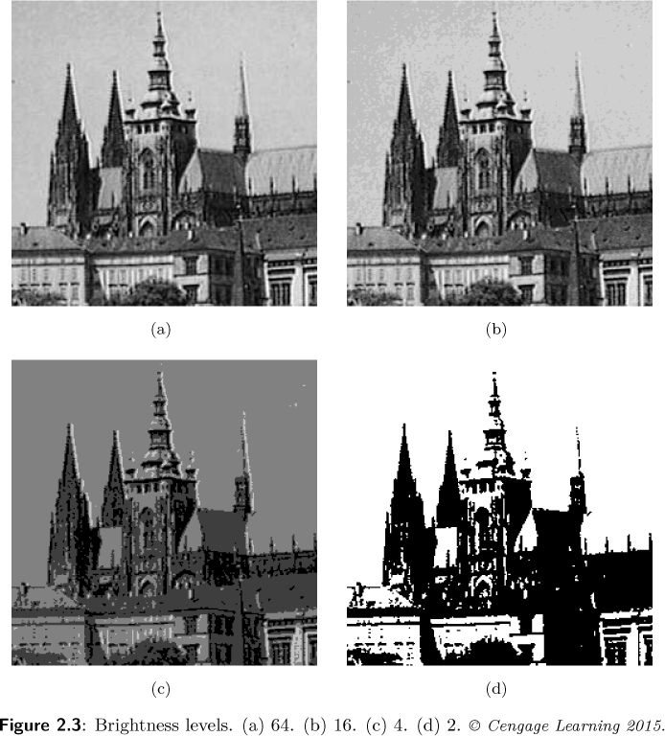
Quantization
Image Processing, Analysis, and Machine Vision, 4th Edition Sonka, Hlavac & Boyle
The transition between continuous values of the image function (brightness) and its digital equivalent is called quantization.

Slide 9
Digital image properties
Image Processing, Analysis, and Machine Vision, 4th Edition Sonka, Hlavac & Boyle
Matric and topological properties of digital images
Distance (Matric)
Any function D holding the following three condition is a distance (or a metric)
Identity
Symmetry
Triangular inequatility
D(p, q) = 0 iff p = q

Slide 10
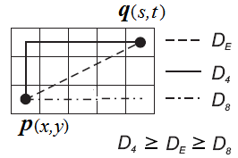
Matric and topological properties of digital images
Image Processing, Analysis, and Machine Vision, 4th Edition Sonka, Hlavac & Boyle
Euclidean distance
City block distance
Chessboard distance

Slide 11

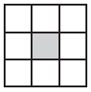
Matric and topological properties of digital images
Image Processing, Analysis, and Machine Vision, 4th Edition Sonka, Hlavac & Boyle
Regions
A region is a connected set.
A region is a set of pixels in which there is a path between any pair of its pixels, all of those pixels also belong to the set.
4-neighbors v.s. 8-neighbors

Slide 12

Matric and topological properties of digital images
Image Processing, Analysis, and Machine Vision, 4th Edition Sonka, Hlavac & Boyle
Contiguous (接觸的;鄰近的)
If there is a path between two pixels in the set of pixels in the image, these pixels are called contiguous.
The relation ‘to be contiguous’ is reflexive, symmetric, and transitive.
‘To be contiguous’ can be used to decompose an image into individual regions.
The character is decomposed into 3 regions.

Slide 13
Matric and topological properties of digital images
Image Processing, Analysis, and Machine Vision, 4th Edition Sonka, Hlavac & Boyle
Multiple Contiguous
Let R be the union of all regions R_{i} (these regions do not touch the image bounds), and
R^{C} be the set complement of R with respect to the image.
The subset of R^{C} which is contiguous with the image bound is called the background, and the remainder of the complement R^{C} is called holes.
A region is called simple contiguous if it has no holes.
The complement of a simply contiguous region is contiguous.
A region with holes is called multiple contiguous.

Slide 14
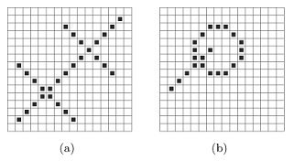
Matric and topological properties of digital images
Image Processing, Analysis, and Machine Vision, 4th Edition Sonka, Hlavac & Boyle
The figure (a) shows two digital line segments with 45º slope.
If 4-connectivity is used, the line are not contiguous at each of their points.
Two perpendicular lines do intersect in one case (upper right intersection) and do not intersect in another case (lower left).
One possible solution: to treat objects using 4-neighborhoods and background using 8-neighborhoods

Slide 15
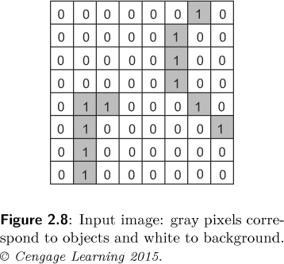
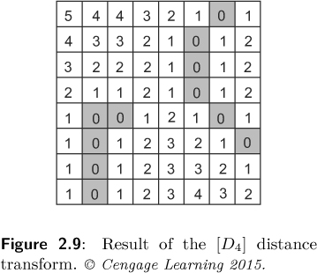
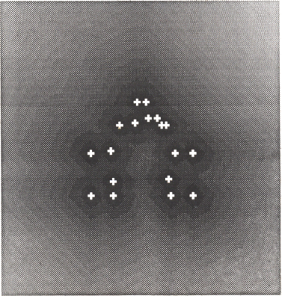
Matric and topological properties of digital images
Image Processing, Analysis, and Machine Vision, 4th Edition Sonka, Hlavac & Boyle
Chamfer(導角;倒角) distance
A simple application of the concept of distance
For example, consider a binary image,

Slide 16
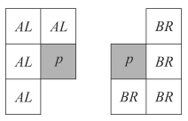
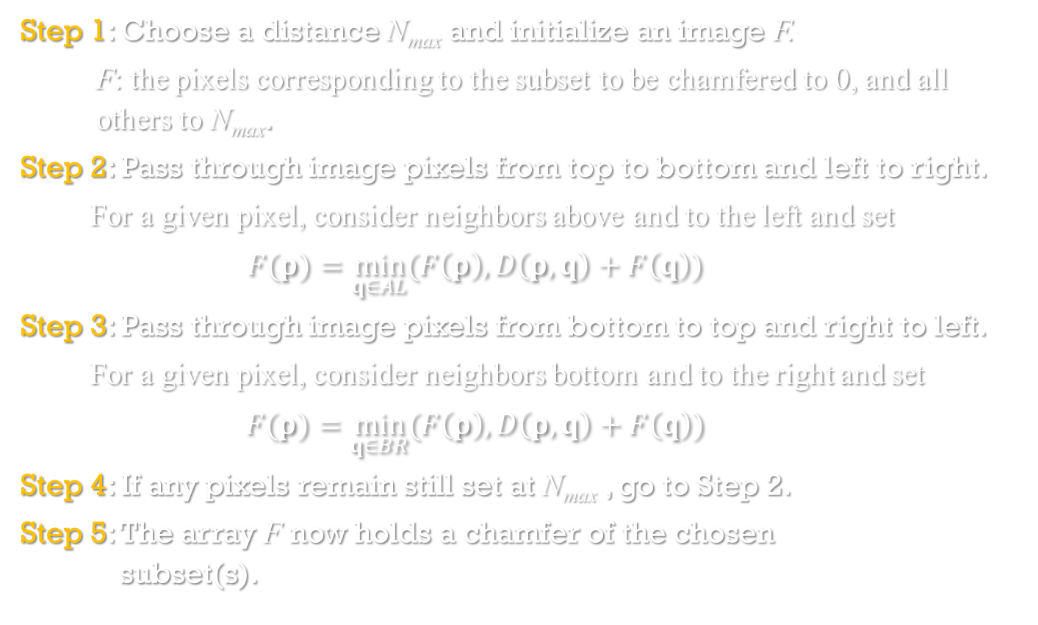
Algorithm 2.1: Distance transformation
Image Processing, Analysis, and Machine Vision, 4th Edition Sonka, Hlavac & Boyle
Step 1: Choose a distance N_{max} and initialize an image F.
F: the pixels corresponding to the subset to be chamfered to 0, and all others to N_{max}.
Step 2: Pass through image pixels from top to bottom and left to right.
For a given pixel, consider neighbors above and to the left and set
$$F(p)=\min_{q∈AL}{(F\left(p\right),D\left(p,q\right)+F\left(q\right))}$$
Step 3: Pass through image pixels from bottom to top and right to left.
For a given pixel, consider neighbors bottom and to the right and set
$$F(p)=\min_{q∈BR}{(F\left(p\right),D\left(p,q\right)+F\left(q\right))}$$
Step 4: If any pixels remain still set at N_{max} , go to Step 2.
Step 5: The array F now holds a chamfer of the chosen subset(s).

Slide 17
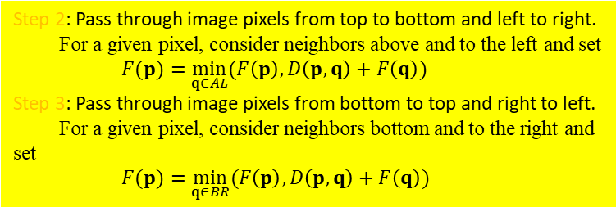
1 | 1 | 1 | 1 | 1 | 1 | 1 | 1
1 | 1 | 1 | 0 | 1 | 1 | 1 | 1
1 | 1 | 1 | 0 | 1 | 1 | 1 | 1
1 | 1 | 1 | 0 | 1 | 1 | 1 | 1
1 | 1 | 1 | 0 | 0 | 1 | 1 | 1
1 | 1 | 1 | 0 | 0 | 0 | 0 | 1
1 | 1 | 1 | 0 | 0 | 0 | 1 | 1
1 | 1 | 1 | 1 | 1 | 1 | 1 | 1
255 | 255 | 255 | 255 | 255 | 255 | 255 | 255
255 | 255 | 255 | 0 | 255 | 255 | 255 | 255
255 | 255 | 255 | 0 | 255 | 255 | 255 | 255
255 | 255 | 255 | 0 | 255 | 255 | 255 | 255
255 | 255 | 255 | 0 | 0 | 255 | 255 | 255
255 | 255 | 255 | 0 | 0 | 0 | 0 | 255
255 | 255 | 255 | 0 | 0 | 0 | 255 | 255
255 | 255 | 255 | 255 | 255 | 255 | 255 | 255
255 | 255 | 255 | 255 | 255 | 255 | 255 | 255
255 | 255 | 255 | 0 | 255 | 255 | 255 | 255
255 | 255 | 255 | 0 | 255 | 255 | 255 | 255
255 | 255 | 255 | 0 | 0 | 255 | 255 | 255
255 | 255 | 255 | 0 | 0 | 0 | 0 | 255
255 | 255 | 255 | 0 | 0 | 0 | 255 | 255
255 | 255 | 255 | 255 | 255 | 255 | 255 | 255
255 | 255 | 255 | 255 | 255 | 255 | 255 | 255
Step 2: Pass through image pixels from top to bottom and left to right.
For a given pixel, consider neighbors above and to the left and set
$$F(p)=\min_{q∈AL}{(F\left(p\right),D\left(p,q\right)+F\left(q\right))}$$
Step 3: Pass through image pixels from bottom to top and right to left.
For a given pixel, consider neighbors bottom and to the right and set
$$F(p)=\min_{q∈BR}{(F\left(p\right),D\left(p,q\right)+F\left(q\right))}$$

Slide 18
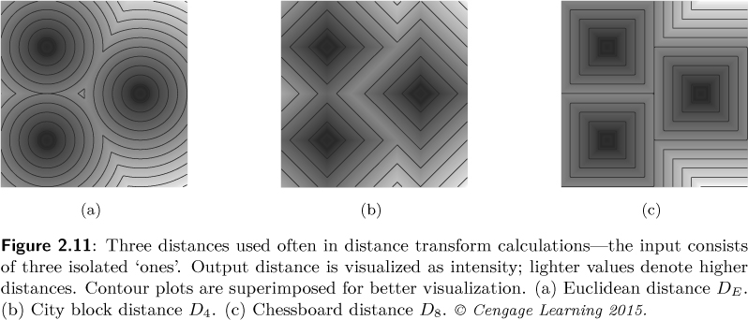
Matric and topological properties of digital images
Image Processing, Analysis, and Machine Vision, 4th Edition Sonka, Hlavac & Boyle
The relationship between different distance functions and algorithm 2.1.
Euclidean distance, city block distance, and chessboard distance

Slide 19

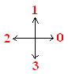
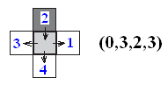
Matric and topological properties of digital images
Image Processing, Analysis, and Machine Vision, 4th Edition Sonka, Hlavac & Boyle
Edge
A local property of a pixel and its immediate neighborhood
It is a vector given by a magnitude and direction which tell us how fast the image intensity varies in a small neighborhood of a pixel.
Crack (裂縫) edge:
Define a relationship between a pixel and its 4-neighbors.
Each pixel has four crack edges.
(1,2,3,4)

Slide 20
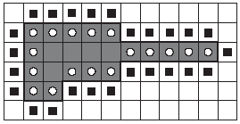
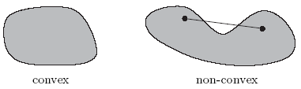
Matric and topological properties of digital images
Image Processing, Analysis, and Machine Vision, 4th Edition Sonka, Hlavac & Boyle
Inner borders and outer borders of a region
Region inner borders shown as white circles and outer borders shown as black squares (using 4-neighborhoods).
Convex region

Slide 21

Matric and topological properties of digital images
Image Processing, Analysis, and Machine Vision, 4th Edition Sonka, Hlavac & Boyle
Convex hull
A convex hull of a region is the smallest convex region containing the input region.
Topological (拓撲學的) properties
Topological properties are invariant to homeomorphic (同胚 ) transforms.
For example, rubber sheet transforms
Imagine a small rubber balloon with an object painted on it.
Topological properties of the object are those which are invariant to arbitrary stretching of the rubber sheet.
Stretching does not change contiguity of the object parts and does not change the number of holes in regions.
http://www.corrmap.com/features/rubber-sheeting_transformation.php

Slide 22
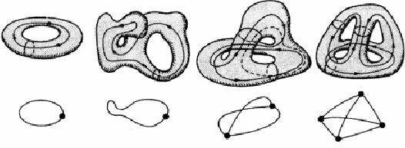

Topological properties
Topology is concerned with the properties of space that are preserved under continuous deformations, such as stretching (拉伸) and bending (彎曲), but not tearing (撕開) or gluing (黏合).
Example of the topological properties: genus and connectivity (a-d) have a connectivity of 1, 1, 2, and 3 respectively(MacDonald et. al. , 1986).
https://www.researchgate.net/figure/267246393_fig10_Fig-211-Example-of-the-topological-properties-genus-and-connectivity-a-d-have-a
https://en.wikipedia.org/wiki/Topology

Slide 23

Matric and topological properties of digital images
Image Processing, Analysis, and Machine Vision, 4th Edition Sonka, Hlavac & Boyle
Topological properties
An object with non-regular shape can be represented by a collection of its topological components.
The set inside the convex hull which does not belong to an object is called the deficit (不足額) of convexity, including lakes and bays.
Lakes are fully surrounded by the object.
Bays are contiguous with the border of the convex hull of the object.

Slide 24
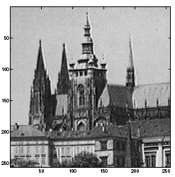
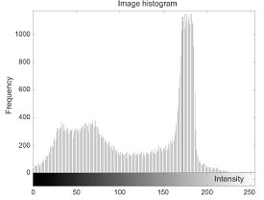
Histograms
Image Processing, Analysis, and Machine Vision, 4th Edition Sonka, Hlavac & Boyle
The brightness histogram of an image provides the frequency of the brightness value in the image.
Local smoothing of the histogram
To reduce the number of local minima and maxima

Slide 25
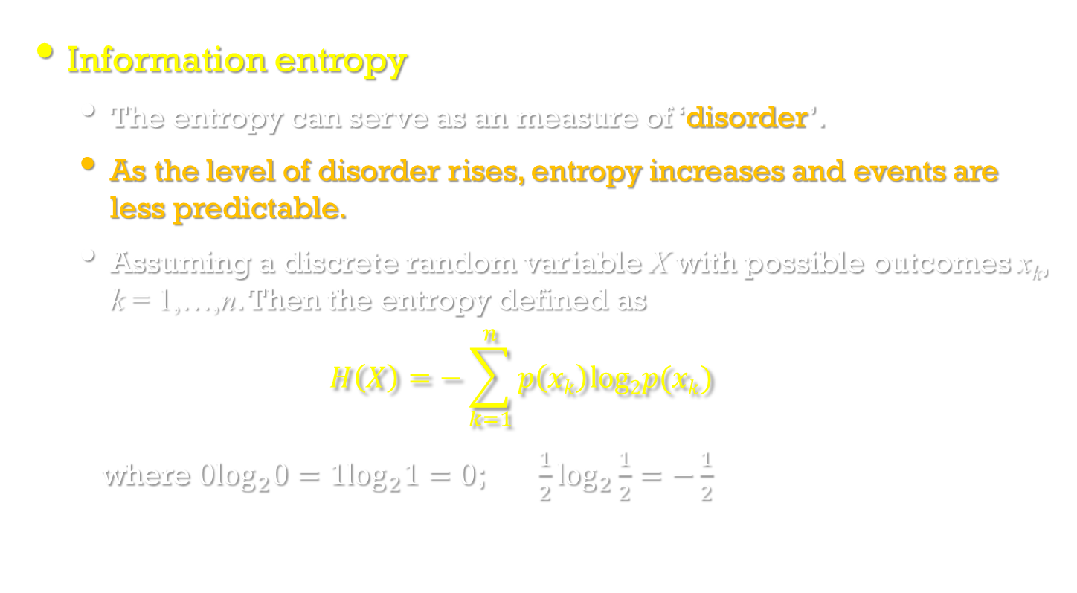
Entropy
Information entropy
The entropy can serve as an measure of ‘disorder’.
As the level of disorder rises, entropy increases and events are less predictable.
Assuming a discrete random variable X with possible outcomes x_{k}, k = 1,…,n. Then the entropy defined as
$$H\left(X\right)=−\sum_{k=1}^{n}{p\left(xk\right)log2p(xk)}$$
where $0\log_{2}0=1\log_{2}1=0$; $\frac{1}{2}\log_{2}\frac{1}{2}=−\frac{1}{2}$

Slide 26

Visual perception of the image
Image Processing, Analysis, and Machine Vision, 4th Edition Sonka, Hlavac & Boyle
Contrast
Contrast is the local change in brightness and is defined as the ratio between average brightness of an object and the background.
Conditional contrast effect
Circles inside squares have the same brightness.
Human perceive the brightness of the small circles as different.

Slide 27
Visual perception of the image
Image Processing, Analysis, and Machine Vision, 4th Edition Sonka, Hlavac & Boyle
Acuity (敏銳)
Acuity is the ability to detect details in an image.
The human eye is less sensitive to slow and fast changes in brightness in the image plane but more sensitive to intermediate (中間的) changes.
Acuity also decreases with increasing distance from the optical axis (光軸).
Resolution in an image is bounded by the resolution ability of the human eye.

Slide 28

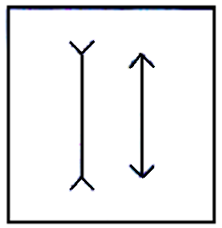
Visual perception of the image
Image Processing, Analysis, and Machine Vision, 4th Edition Sonka, Hlavac & Boyle
Some visual illusions (錯覺)
Human perception of images is prone (易於) to many illusions.
Object borders
Boundaries of objects and simple patterns such as blobs or lines enable adaptation effects similar to conditional contrast.
For example, the Ebbinghaus illusion (艾賓浩斯錯覺)

Slide 29
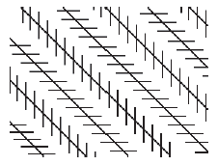
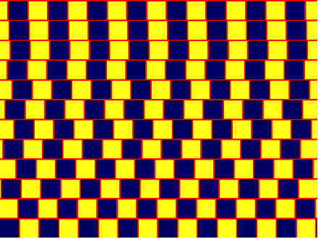
Visual perception of the image
Image Processing, Analysis, and Machine Vision, 4th Edition Sonka, Hlavac & Boyle
Some visual illusions (錯覺)
Parallel diagonal line segments which are not perceived as parallel. (left image)
Horizontal lines are parallel, although not perceived as such. (right image)

Slide 30
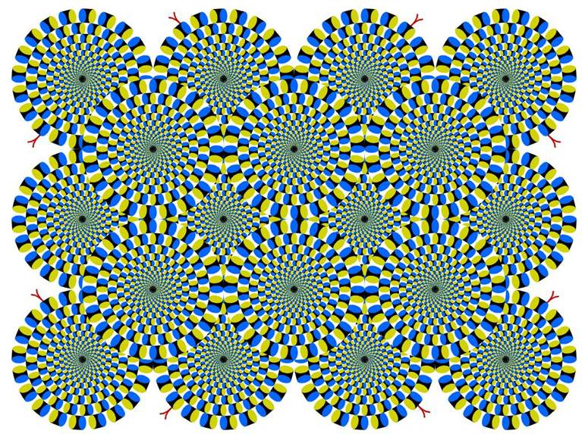
If something is rotating – go home, you need a break!

Slide 31
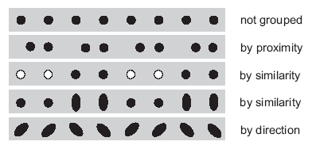
Visual perception of the image
Image Processing, Analysis, and Machine Vision, 4th Edition Sonka, Hlavac & Boyle
Perceptual (知覺) grouping
The human ability to group items according to various properties is illustrated in the figure.

Slide 32

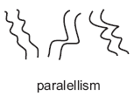

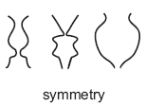
Visual perception of the image
Image Processing, Analysis, and Machine Vision, 4th Edition Sonka, Hlavac & Boyle
Perceptual grouping
Perceived properties help people to connect elements together (in cluttered scenes) based on strongly perceived properties as parallelism, symmetry, continuity and closure.

Slide 33
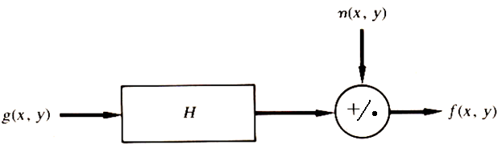
Image quality
Image degradation (退化;下降)
An image might be degraded (退化) during capture, transmission, or processing.
Measures of image quality can be used to assess the degree of degradation.
Image degradation (影像劣化;影像衰退) model H
g(x,y): input image
f(x,y): degraded image
H: degradation process
n(x,y): noise

Slide 34

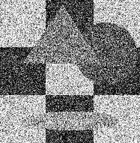
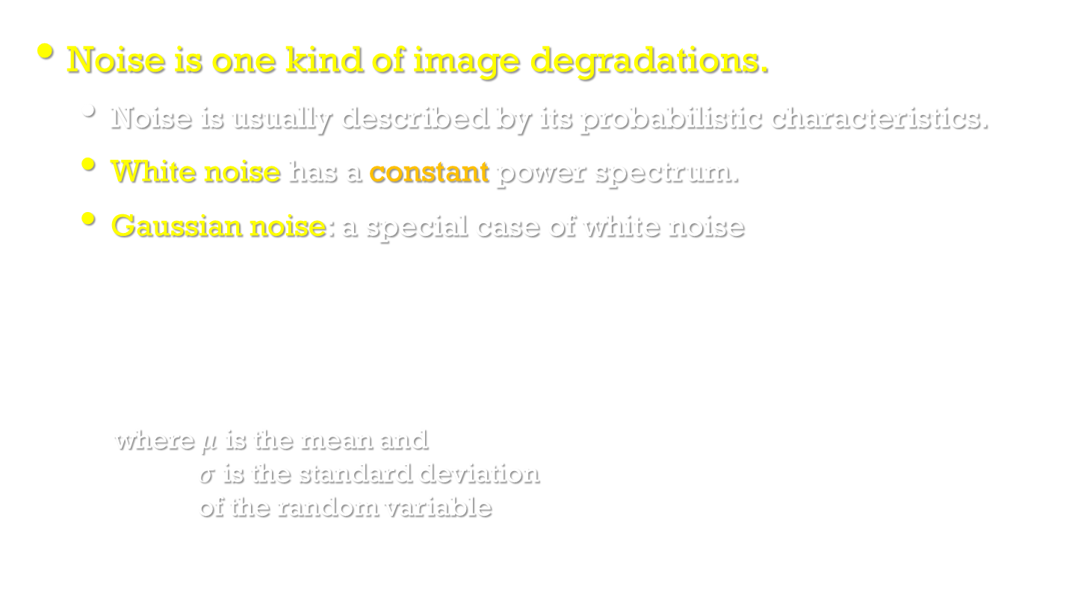
Noise in images
Image Processing, Analysis, and Machine Vision, 4th Edition Sonka, Hlavac & Boyle
Noise is one kind of image degradations.
Noise is usually described by its probabilistic characteristics.
White noise has a constant power spectrum.
Gaussian noise: a special case of white noise
where $μ$ is the mean and $σ$ is the standard deviation of the random variable
white noise:
https://zh.wikipedia.org/wiki/%E7%99%BD%E9%9B%9C%E8%A8%8A

Slide 35
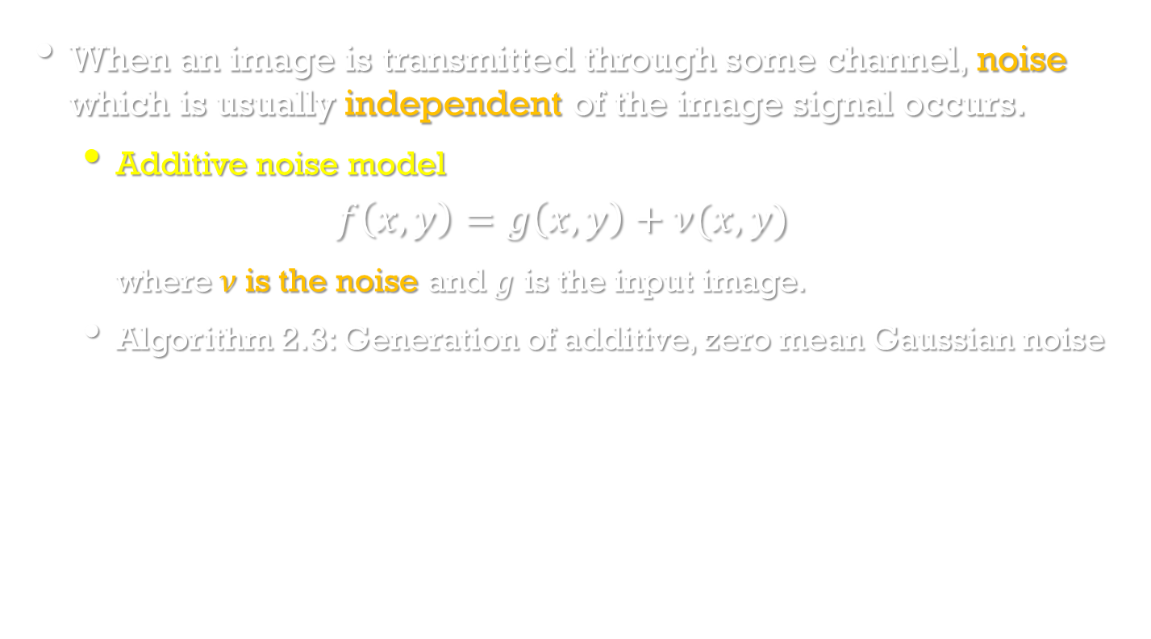
Noise in images
Image Processing, Analysis, and Machine Vision, 4th Edition Sonka, Hlavac & Boyle
When an image is transmitted through some channel, noise which is usually independent of the image signal occurs.
Additive noise model
$$f\left(x,y\right)=g\left(x,y\right)+ν(x,y)$$
where$ν$ is the noise and $g$ is the input image.
Algorithm 2.3: Generation of additive, zero mean Gaussian noise

Slide 36
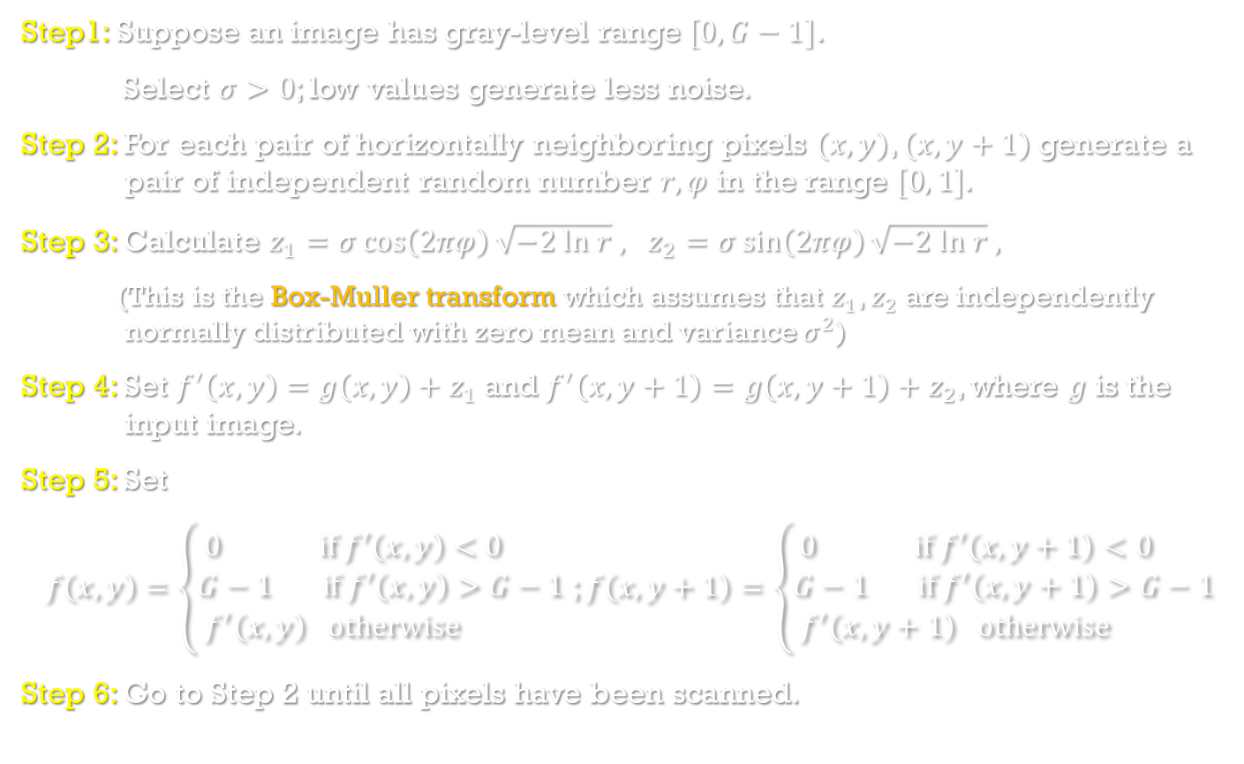
Algorithm 2.3: Generation of additive, zero mean Gaussian noise
Step1: Suppose an image has gray-level range $[0,G−1]$.
Select $σ>0$; low values generate less noise.
Step 2: For each pair of horizontally neighboring pixels $(x,y)$, $(x,y+1)$ generate a pair of independent random number $r,φ$ in the range $[0, 1]$.
Step 3: Calculate $z_{1}=σ\cos\left(2πφ\right)\sqrt{−2 ln r} ,$ $z_{2}=σ\sin\left(2πφ\right)\sqrt{−2 ln r} ,$
(This is the Box-Muller transform which assumes that $z_{1}$, $z_{2}$ are independently normally distributed with zero mean and variance $σ^{2}$)
Step 4: Set $f^{′}\left(x,y\right)=g\left(x,y\right)+z_{1}$ and $f^{′}\left(x,y+1\right)=g\left(x,y+1\right)+z_{2}$, where $g$ is the input image.
Step 5: Set
$f\left(x,y\right)=\left\{\begin{aligned}0 if f^{′}\left(x,y\right)<0 \\ G−1 if f^{′}\left(x,y\right)>G−1 \\ f^{′}\left(x,y\right) otherwise \end{aligned}\right.$; $f\left(x,y+1\right)=\left\{\begin{aligned}0 if f^{′}\left(x,y+1\right)<0 \\ G−1 if f^{′}\left(x,y+1\right)>G−1 \\ f^{′}\left(x,y+1\right) otherwise \end{aligned}\right.$
Step 6: Go to Step 2 until all pixels have been scanned.

Slide 37
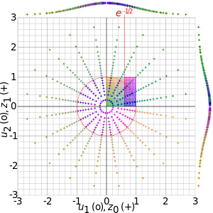
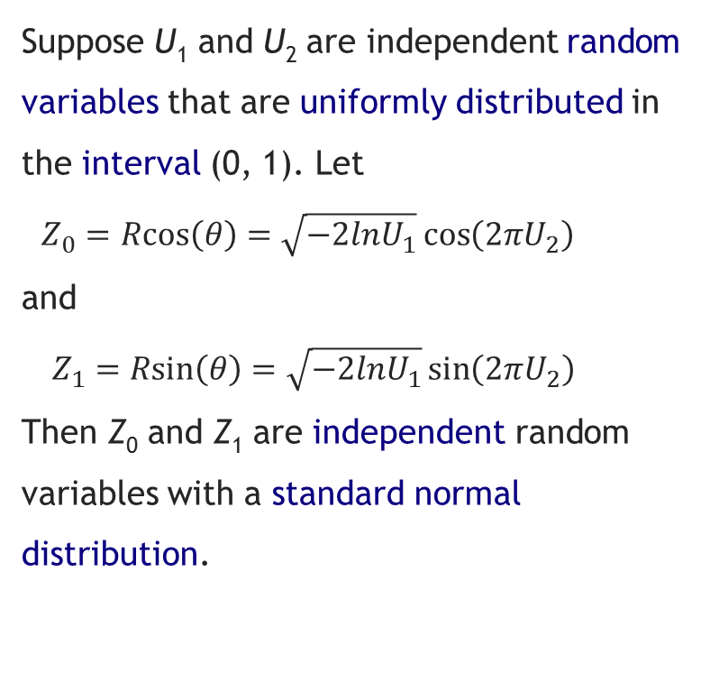
Box–Muller transform
Suppose U₁ and U₂ are independent random variables that are uniformly distributed in the interval (0, 1). Let
$Z_{0}=Rcos\left(θ\right)=\sqrt{−2lnU_{1}}\cos\left(2πU_{2}\right)$
and
$Z_{1}=Rsin\left(θ\right)=\sqrt{−2lnU_{1}}\sin\left(2πU_{2}\right)$
Then Z₀ and Z₁ are independent random variables with a standard normal distribution.
Visualisation of the Box–Muller transform — the coloured points in the unit square (u₁, u₂), drawn as circles, are mapped to a 2D Gaussian (z₀, z₁), drawn as crosses. The plots at the margins are the probability distribution functions of z₀ and z₁. Note that z₀ and z₁ are unbounded; they appear to be in [-3,3] due to the choice of the illustrated points.
https://en.wikipedia.org/wiki/Box%E2%80%93Muller_transform#cite_note-4

Slide 38

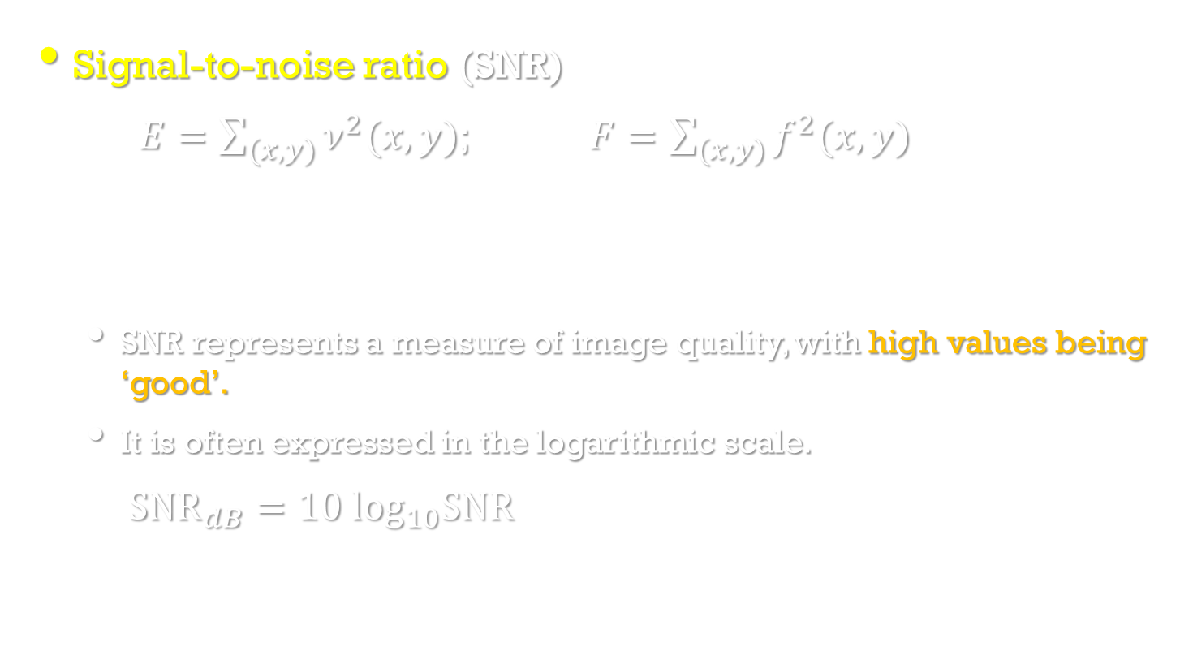
Noise in images
Image Processing, Analysis, and Machine Vision, 4th Edition Sonka, Hlavac & Boyle
Signal-to-noise ratio (SNR)
$E=\sum_{(x,y)}{ν^{2}(x,y)}$; $F=\sum_{(x,y)}{f^{2}(x,y)}$
SNR represents a measure of image quality, with high values being ‘good’.
It is often expressed in the logarithmic scale.
${SNR}_{dB}=10\log_{10}SNR$
$$SNR= \frac{F}{E}$$

Slide 39

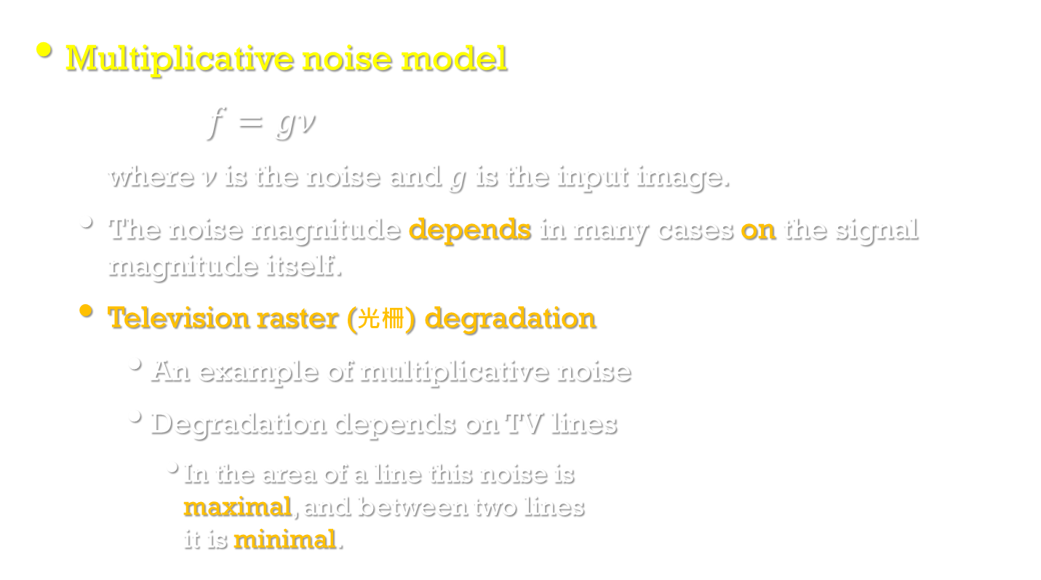
Noise in images
Multiplicative noise model
$f=gν$
where$ν$ is the noise and $g$ is the input image.
The noise magnitude depends in many cases on the signal magnitude itself.
Television raster (光柵) degradation
An example of multiplicative noise
Degradation depends on TV lines
In the area of a line this noise is maximal, and between two lines it is minimal.
https://taratrangmarvideoproduction.wordpress.com/2012/10/16/the-tv-lines/

Slide 40
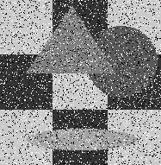
Noise in images
Quantization noise
Quantization noise occurs when insufficient quantization levels are used.
For example, 50 levels for a monochromatic (單色) image.
Impulse noise
Impulse noise means that an image is corrupted with individual noisy pixels whose brightness differs significantly from that of the neighborhood.
For example, salt-and-pepper noise
An image is corrupted with white and/or black pixels

Slide 41
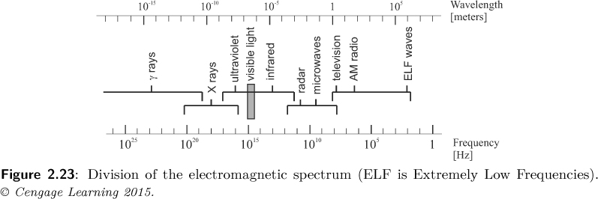
Color images
Image Processing, Analysis, and Machine Vision, 4th Edition Sonka, Hlavac & Boyle
Physics of color
The world is colorless.
Human color perception is carried out by the nervous system, which interprets differently to distinct electromagnetic wavelengths (電磁波長 ).
Electromagnetic spectrum (電磁頻譜 )

Slide 42
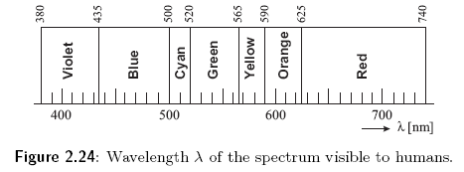
Physics of color
Image Processing, Analysis, and Machine Vision, 4th Edition Sonka, Hlavac & Boyle
Visible spectral colors
Colors can be represented as combinations of the primary colors.
Primary colors: red, green and blue
1 nm = 10⁻⁹ m

Slide 43
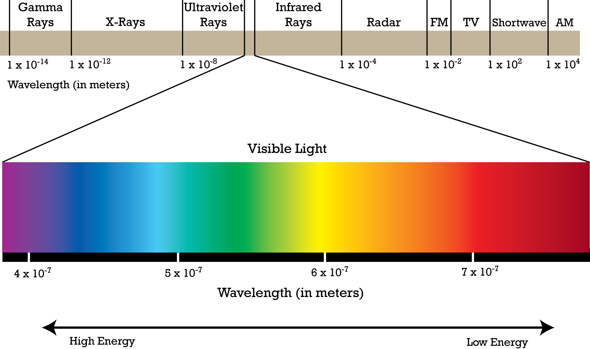
Electromagnetic spectrum

Slide 44
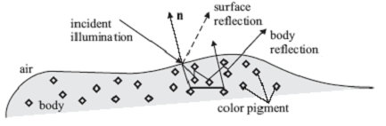
Physics of color
Image Processing, Analysis, and Machine Vision, 4th Edition Sonka, Hlavac & Boyle
Why do we see the world in color?
The surface reflection rebounds (反彈) incoming energy from the surface, whose spectrum remains the same as that of the light source.
It is independent of the surface (do not have a color).
The energy diffuses (漫射) into the material and reflects randomly from the internal pigment (顏料;色素) in the matter. (body reflection)
Observed color of objects is caused by certain wavelength absorptions (吸收) by pigment particles in dielectrics (電介質 ).

Slide 45
Color perceived by humans
Image Processing, Analysis, and Machine Vision, 4th Edition Sonka, Hlavac & Boyle
Retina (視網膜) is composed of photoreceptors (感光器).
Two types of photoreceptors
Rods: sensitive to intensity
Cones: sensitive to color
PS 視桿細胞(rod cell) v.s. 視錐細胞(cone cell)
視桿細胞主要與暗視覺有關( 對光線的明暗變化、形態與移動特別敏感 )，分佈在視網膜周邊部。
視錐細胞則與光視覺有關(用來辨別色彩，並適合偵測各種細節 )，分佈在視網膜中心部，中央小凹( foveola )只有視錐細胞。
PS 眼球構造圖 https://mulicia.pixnet.net/blog/post/4213181

Slide 46
Color perceived by humans
Image Processing, Analysis, and Machine Vision, 4th Edition Sonka, Hlavac & Boyle
Types of cones: L(red), M(green), S(blue)
The figure shows relative sensitivity of S, M, L cones of the human eye to wavelength.
色盲資訊 https://zh.wikipedia.org/wiki/%E8%89%B2%E7%9B%B2
http://blog.fourdesire.com/2014/12/11/wo-he-ni-you-dian-bu-yang-zhen-dui-se-mang-zhe-de-ti-tie-she-ji/

Slide 47



Color perceived by humans
Image Processing, Analysis, and Machine Vision, 4th Edition Sonka, Hlavac & Boyle
RGB color space
Given primary colors R, G, B, then color matching functions can be obtained by
$C\left(λ\right)=w_{1}\left(λ\right)R+w_{2}\left(λ\right)G+w_{3}\left(λ\right)B$;
where $w_{1}\left(λ\right),w_{2}\left(λ\right),w_{3}\left(λ\right)$ may be negative.
https://www.itp.uni-hannover.de/~zawischa/ITP/colmetr.html

Slide 48



Color perceived by humans
Image Processing, Analysis, and Machine Vision, 4th Edition Sonka, Hlavac & Boyle
CIE XYZ color space
CIE: an organization responsible for color standard
Commission internationale de l'éclairage (French)
International Commission on Illumination
國際照明委員會
XYZ
Y: brightness (luminance)
The actual color is a mixture of
$c_{X}X+c_{Y}Y+c_{Z}Z$
where $0{≤c}_{X},c_{Y},c_{Z}≤1$ are weights in the mixture
CIE XYZ color space
https://zh.wikipedia.org/wiki/CIE1931%E8%89%B2%E5%BD%A9%E7%A9%BA%E9%97%B4

Slide 49


Color perceived by humans
Image Processing, Analysis, and Machine Vision, 4th Edition Sonka, Hlavac & Boyle
Color gamut (色域)
The subspace of colors perceivable by humans is called the color gamut.
http://www.avsforum.com/forum/465-high-dynamic-range-hdr-wide-color-gamut-wcg/2442082-hdr-misconceptions-still-prevail-3.html

Slide 50


Color perceived by humans
Image Processing, Analysis, and Machine Vision, 4th Edition Sonka, Hlavac & Boyle
The CIE 1931 color space chromaticity diagram (色度圖)
CIE chromaticity diagram is a projection of XYZ color space into a plane.
The triangle depicts a subset of colors spanned by red, green, and blue. These are TV colors, i.e., all possible colors, which can be seen on a CRT display.
Given X, Y, Z, then x, y, z can be obtained by
$x=\frac{X}{X+Y+Z}$; $y=\frac{Y}{X+Y+Z}$
$z=1−x−y$

Slide 51




Color perceived by humans
Image Processing, Analysis, and Machine Vision, 4th Edition Sonka, Hlavac & Boyle
Display and printing devices use three selected real primary colors.

Slide 52


Color spaces
Image Processing, Analysis, and Machine Vision, 4th Edition Sonka, Hlavac & Boyle
RGB color space

Slide 53


Color spaces
One of the transformations between RGB and XYZ color space
$\left[\begin{matrix}R \\ G \\ B\end{matrix}\right]=\left[\begin{matrix}3.24 & −1.54 & −0.50 \\ −0.98 & 1.88 & 0.04 \\ 0.06 & −0.20 & 1.06\end{matrix}\right]\left[\begin{matrix}X \\ Y \\ Z\end{matrix}\right]$ $\left[\begin{matrix}X \\ Y \\ Z\end{matrix}\right]=\left[\begin{matrix}0.41 & 0.36 & 0.18 \\ 0.21 & 0.72 & 0.07 \\ 0.02 & 0.12 & 0.95\end{matrix}\right]\left[\begin{matrix}R \\ G \\ B\end{matrix}\right]$
CMY color space (Cyan, Magenta, Yellow)
CMY color model uses subtractive color mixing which is used in printing processes.
CMYK (K: black) stores ink values for black in addition.
https://www.w3schools.com/colors/colors_converter.asp
減色法https://zh.wikipedia.org/wiki/%E6%B8%9B%E8%89%B2%E6%B3%95

Slide 54


Color spaces
Image Processing, Analysis, and Machine Vision, 4th Edition Sonka, Hlavac & Boyle
HSV color model (Hue, Saturation, and Value)
HSV color model is illustrated as a cylinder.
HSV v.s. HSL: https://en.wikipedia.org/wiki/HSL_and_HSV

Slide 55

Palette images
Palette images (indexed images;調色板) provide a simple way to reduce the amount of data needed to represent an image.
The pixel values constitute a link to a lookup table (palette; 調色板).
The table contains as many entries as the range of possible values in the pixels which is typically 8 bits (256 values).
For example, (8-bit color, with three bits of red, three bits of green, and two bits of blue)

Slide 56

Palette images
http://www.technologyuk.net/computing/computer-systems/display-adapter.shtml

Slide 57


Color constancy
Image Processing, Analysis, and Machine Vision, 4th Edition Sonka, Hlavac & Boyle
Color constancy (顏色恆定)
Surfaces have different colors and brightness when viewed under different lights.
The human vision system is able to abstract to a certain degree from the illumination changes and perceive several instances of a particular color as the same.

